Slide 1
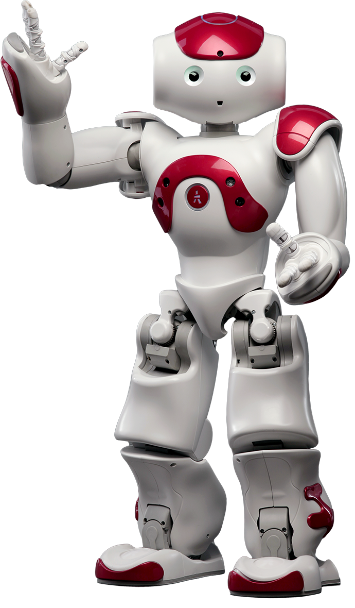
NAO ROBOT

Slide 2
Summary
1) What is Nao Robot
2) Capabilities
  2.1) Object recognition
  2.2) Speaking
  2.3) Sound detection
  2.4) Fall manager
3) Specifications
4) Conclusion

Slide 3
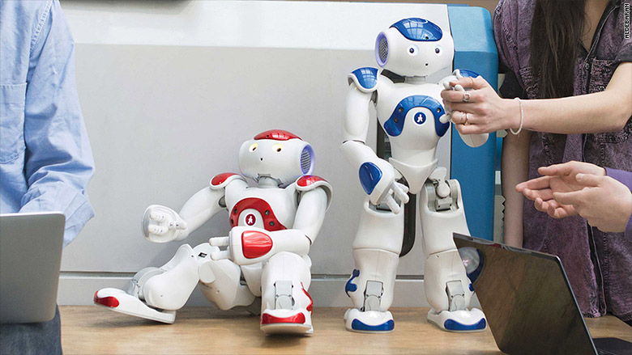
What is Nao ?
NAO is a 58-cm tall, 5-kg humanoid robot developed by Aldebaran Robotics, a French robotics company headquartered in Paris. It is a completely programmable, autonomous, and interactive robot. It is used today in research and education around the world in prestigious universities and research institutes.

Slide 4
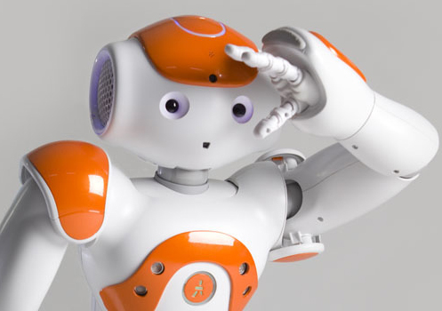
2.1) Object recognition
NAO has the capacity to recognize a large quantity of objects. Once the object is saved thanks to Choregraphe software, if he sees it again, NAO is able to recognize and say what it is.

Slide 5

2.2) Speaking
NAO is able to speak up to 9 languages. With a "say box" in Choregraphe you can insert text and modify voice parameters as you wish. It will say the text correctly, with the right punctuation and intonation.

Slide 6

2.3) Sound Detection
Our environment is made of sounds that NAO, like us, is able to detect and localize in the space thanks to integrated microphones.

Slide 7
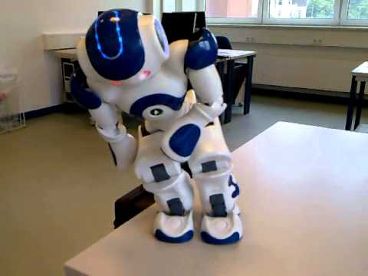
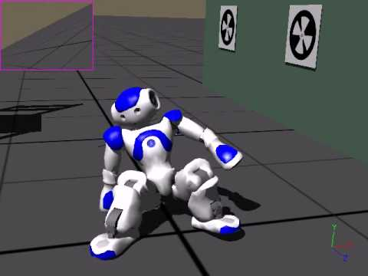
2.4) Fall manager
NAO may fall, but you can taught it on how to stand up by itself. and provide it with a fall detection system: before hitting the ground, it will protects itself with his arms.

Slide 8
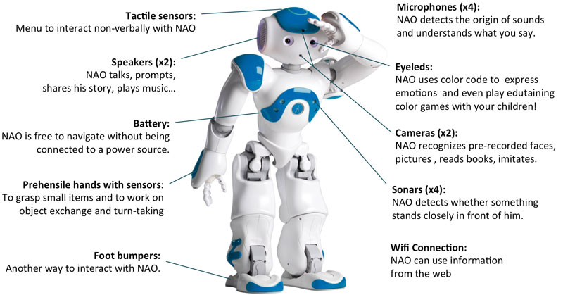
Specifications

Slide 9
Conclusion
The NAO robot is capable of, listening, understanding, obeying commands, answering questions, talking. walking, sitting, standing up, dancing, kicking and many more !
So i’m sure now that you all understand why the NAO robot is a very special robot.

Slide 10

Thanks

Slide 11
Bonus
Nao Robot Dance Thriller

